Slide 1


WHO Regional Office for Europe work in preparing for COVID-19 vaccination and deployment
WHO Regional webinar on Preparedness for COVID-19 Vaccination
8 October 2020

Slide 2
Presentation outline
Global platform for COVID-19 response: the ACT Accelerator and COVAX
Participation of countries of the WHO European Region in the COVAX Facility
Regional framework to support preparedness for COVID-19 vaccination
Regional support in developing and implementing national plans on COVID-19 vaccines deployment and vaccination

Slide 3












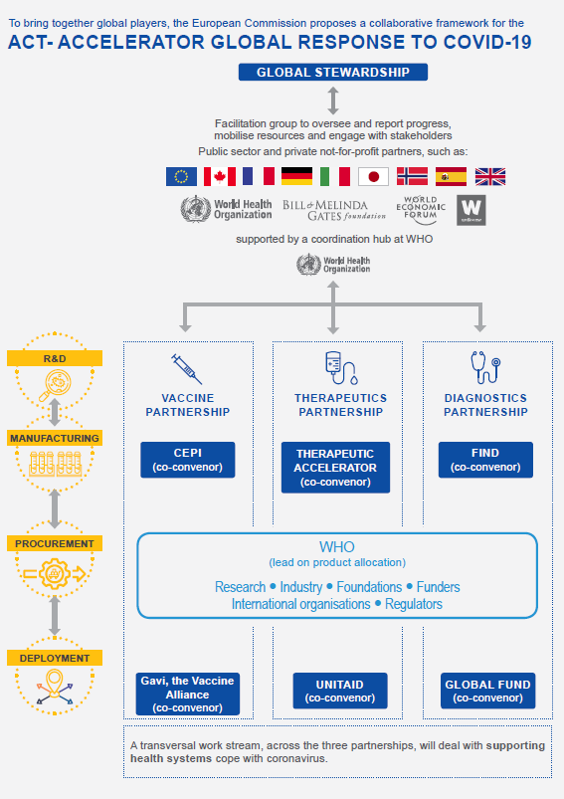
The ACT-Accelerator structures COVID-19 global response efforts in a collaborative framework across three partnerships
Global Stewardship
Facilitation group to oversee and report progress, mobilise resources and engage with stakeholders
Public sector and private not-for-profit partners, such as:
Supported by a coordination hub at WHO
Vaccine partnership
Therapeutics partnership
Diagnostics partnership
R&D
CEPI
(co-convenor)
Therapeutics Accelerator
(co-convenor)
Find
(co-convenor)
Manufacturing
WHO
lead on product allocation
Research ● Industry ● Foundations ● Funders international organizations ● Regulators
Procurement
Gavi, the vaccine Alliance
(co-convenor)
UNITAID
(co-convenor)
Global Fund
(co-convenor)
Deployment
COVAX facility
Country Readiness & Delivery
Transversal Health Systems Working Group

Slide 4
The COVID-19 Vaccine Global Access (COVAX) Facility enables global collaboration and equitable access to vaccines
The COVAX Facility is administered by the Gavi Secretariat and
implemented in partnership with ACT Accelerator actors
Donor subsidised doses²
Donors on behalf of LICs/ LMICs
The COVAX Facility
LICs/ LMICs
Gavi COVAX AMC
Manufacturers
Contribution
Additional innovative finance instruments
Fully self-financing countries
Fully self-financing countries
Supply agreements¹
(market wide/ manufacturer specific)
Self-funded doses²
1 Agreements with manufacturers would be unified across full scope of countries participating in the Facility, but ODA funding will only be used to support LICs and LMICs
2 Financing for procurement incremental to contribution

Slide 5
Access & allocation as it applies to the COVAX facility*
Goal
Protect public health and minimize societal and economic impact by reducing COVID-19 mortality
Further priority groups
High-risk adults
Indicative target groups
Health and social care workers
All countries receive doses to cover 3% of their population.
This would be enough to cover all workers involved in health and social care work in most countries.
All countries receive additional doses to cover a total of 20% of their population (in tranches)
This could include the elderly, adults with comorbities or others depending on locally relevant risk factors
Countries receive doses to cover more than 20% of their population.
This would cover additional priority populations.
Timing
Phase 1: Countries receive doses proportionally to their total population*
Phase 2: Timing is based on country need, vulnerability and COVID-19 threat
A buffer will also be set aside for emergency deployment based on immediate needs
*Based on version submitted to Member States for review on 21 August

Slide 6
Vaccine availability projected to be available in Q1 2021, but preparation must start now
Current expectation of vaccine availability and delivery timelines
Target Launch Window (Q2 2021)
2020
2021
Sep
Oct
Nov
Dec
Jan
Feb
Mar
Apr
May
Jun
Vaccine Supply Scenarios
Initial supply available (Scenario 1)*
Initial supply available (Scenarios 2 & 3)*
Vaccine Allocation for AMC Countries
Application materials available
AMC participants prepare application (e.g. NVDP)
Review & Allocation decision
Shipment of vaccines
Key activities for the upcoming months

Slide 7
Fully self-financing countries which have signed commitment agreements with COVAX facility (n=35)
Fully self-financing countries which have submitted their non-binding expression of interest to COVAX facility but did not sign the commitment agreement (n=10)
Non-EU/EEA countries: Albania, Andorra, Azerbaijan, Bosnia and Herzegovina, Georgia, Serbia.
EU/EEA countries (as part of EU initiative of “Team Europe”: Austria, Belgium, Bulgaria, Croatia, Cyprus, Czech Republic, Denmark, Estonia, Finland, France, Germany, Greece, Hungary, Iceland, Ireland, Italy, Latvia, Lithuania, Luxembourg, Malta, Netherlands, Norway, Poland, Portugal, Romania, Slovakia, Slovenia, Spain and Sweden.
Non-EU/EEA countries: Armenia, Israel, Montenegro, North Macedonia, Turkey and Turkmenistan.
Monaco, San Marino and Switzerland.
EU/EEA countries: United Kingdom of Great Britain and Northern Ireland (the).
By 09 October 2020, these countries should commit to the down-payment (depending on joining terms and options; ~15% of total cost of procurement)
By 09 October 2020, countries should send the binding document and commit to the down-payment (depending on joining terms and options; ~15% of total cost of procurement)
Data source: https://www.gavi.org/news/media-room/boost-global-response-covid-19-economies-worldwide-formally-sign-covax-facility

Slide 8
Financially supported countries (n=5) through official development assistance*
Fully self-financing countries which did not submit expression of interest to COVAX facility (n=3)
List of countries: Kyrgyzstan, Republic of Moldova, Tajikistan, Ukraine and Uzbekistan
*Kosovo (United Nations Security Council resolution 1244 (1999)) is eligible as per Gavi’s list
List of countries: Belarus, Kazakhstan and Russian Federation
Data source: WHO HQ shared information and also available here: https://www.gavi.org/news/media-room/92-low-middle-income-economies-eligible-access-covid-19-vaccines-gavi-covax-amc

Slide 9
WHO Europe Regional Working Group on COVID-19 vaccination
Member States,
Regional and National partners, National public health institutes, research institutes, Regional professional bodies/organizations and networks
WHO EURO COVID-19 Incident Management Support Team
REGIONAL OFFICE LEADERSHIP
Global COVID-19 Advisory Mechanisms and Working Groups
INCIDENT LEADERSHIP & MANAGEMENT
ADMIN AND FINANCE
R&D Blueprint Scientific Advisory Committee
COMMUNICATION
COVID-19 vaccine coordination group
FG5. Risk Communication & Behavioral insights
FG2. Immunization strategy & Decision making & Monitoring
FG3. Vaccine market authorization & Safety monitoring
FG4. Vaccine supply, Immunization logistics & Service delivery
FG1. Advocacy & resource mobilization including equitable access
Product Development Vaccine Advisory Committee
COUNTRY OPERATIONS
Global Advisory Committee on Vaccine Safety
EMERGENCY PUBLIC HEALTH MEASURES
SURVEILLANCE, EPI AND ANALYTICS
SAGE working group on COVID-19 vaccines and vaccination
CLINICAL & HEALTH INTERVENTIONS
Access to COVID-19 Tools (ACT) Accelerator Working Groups
KEY ENABLING FUNCTIONS
VACCINE WORKING GROUP
SPECIAL PROJECTS PILLAR
HEALTH SYSTEMS COORDINATION
HUB COORDINATORS
Technical oversight by European Technical Group of Experts on Immunization (ETAGE)

Slide 10


Regional guidelines on routine vaccination during COVID-19 pandemic
Decision making considerations
Key principles
Decision making algorithm
  Questions and answers on vaccination during the COVID-19 pandemic:
    for health care workers
    for parents

Slide 11
Strategic considerations for preparedness for COVID-19 vaccination and deployment in the WHO European Region
  Objectives:
    Guide/Support National Immunization Programmes and Ministries of Health to consider critical areas in preparing for COVID-19 vaccination and deployment
    Allow MoHs to identify and address critical gaps
  Structure:
    Ensure appropriate management structure, advocacy and resources
    Ensure evidence-informed national vaccination strategy
    Ensure adequate legal and regulatory framework facilitating vaccine deployment
    Devise appropriate immunization service delivery modalities
    Ensure appropriate vaccine and supply chain management
    Ensure adequate human resources and security
    Plan for vaccination data and information management
    Plan for vaccine safety monitoring
    Plan for safe injections and waste management
    Address demand generation, ensure community engagement and communication

Slide 12
Webinars on Preparedness for COVID-19 Vaccination for NITAGs
  Participants:
    Chairs and Secretariats of NITAGs and National Immunization Programme Managers from 16 L&MICs
  Objectives:
    Update NITAGs on COVID-19 vaccines in pipeline
    Introduce recommendations of Strategic Advisory Group of Experts on COVID-19 vaccination objectives and target groups
    Share experiences from well-functioning NITAGs in identifying target groups for COVID-19 vaccination
    Discuss NITAGs role in national preparedness for COVID-19 vaccination and define next steps
    Define NITAGs needs for WHO and partners support in developing recommendations on COVID-19 vaccination policy
  Dates:
    8 and 9 October 2020

Slide 13
Meeting of European Technical Advisory Group of Experts
  Objectives:
    ETAGE recommendations on regional adaptation of Strategic Advisory Group of Experts Roadmap for prioritising population groups for vaccines against COVID-19 based on:
      Regional data on COVID-19 disease epidemiology
      Vaccine impact modelling
      Preliminary recommendations of NITAGs (Belgium, France, UNK)
    ETAGE advise on WHO Regional Office support to NITAGs from L&MICs in developing national COVID-19 vaccination strategies
    Dates:
      11-12 November 2020

Slide 14
Operational guidelines on development and implementation of a national deployment and vaccination plan for COVID-19 vaccines
  Objectives:
    Guide the national immunization programmes and Ministries of Health on the key aspects of COVID-19 vaccine deployment and vaccination
    Assist in tailoring global recommendations to the national settings
  Impetus areas:
    Management structure
    Evidence-informed and ethical values-based national vaccination strategy
    Legal and regulatory framework
    Immunization service delivery modalities
    Vaccine and supply chain management
    Vaccination data and information management
    Vaccine safety monitoring
    Safe injections and waste management
    Demand generation, community engagement and communication
  Timeline:
    December 2020

Slide 15
Summary
The Access to COVID-19 Tools (ACT) Accelerator was established to speed up development and delivery to countries of diagnostics, treatments and vaccines
The COVAX Facility is an umbrella mechanism through which demand and resources are pooled to support procurement of, and equitable access to, COVID-19 vaccines
Regional multi-stakeholder platform was established to support countries in building preparedness for COVID-19 vaccination
Regional guidelines on development of national plans on COVID-19 vaccines deployment and vaccination are available
WHO Regional Office for Europe committed to provide continuing support to countries in preparedness for COVID-19 vaccination:
    Conducting webinars for NITAGs and NIP Managers
    Providing tools to support countries in developing and implementing national plans

